Slide 1
Using Citizen Science, Education and Community Involvement – to Preserve, Protect and Restore the Unique Springs and Wetlands of the Southwest
Jeff Depew

Slide 2
Jeff Depew
Professor Emeritus, Webster University
International Campus, St. Louis Missouri
Educator and researcher for over 40 years
Restoration Ecology since the groundbreaking 1988 conference ‘Restoring the Earth’
Citizen Science Researcher and Educator since 1991
Professional Wetland Scientist since 1995.
Assisted in development of Missouri Stream Team, 1988
Field Research involving Bats, Caves, Springs 1998-2015
Researching Climate Change since 1998
EarthDesigns, llc Restoration Ecology, Natural Area Creation and Preservation, Consulting 1976

Slide 3
Current Collaborations
EarthDesigns, LLC, : consulting, education, research and practice since 1976 (www.earthdesigns.com)
Institute for Applied Ecology: environmental education and Summer ‘Forest Bound’ program (www.iae.com)
Santa Fe Botanical Garden: outdoor education courses at Leonora Curtin Wetland Preserve and horticultural education (www.santafebotanicalgarden.org)
Santa Fe Community College: teaching ‘Wetland Ecology’ and ‘Global Climate Change’ (www.sfcc.edu/continuing-education-schedule/ )
Regional Xeriscape/Landscape Architects and Designers; consulting and collaboration
Regional Schools and Community centers: creating ‘natural areas’, consulting for ‘out of the classroom’ activities and education

Slide 4
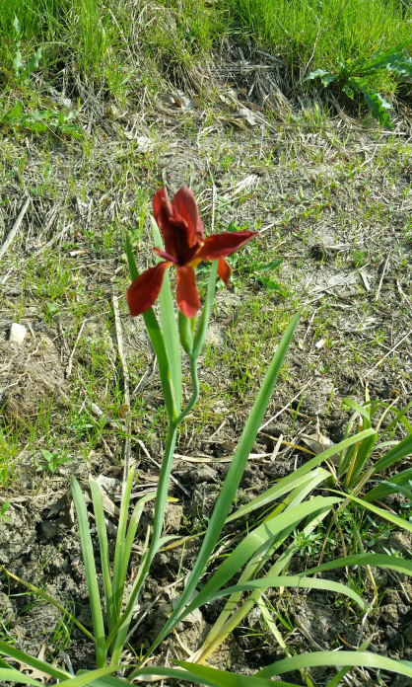
Today’s Topics
Making Connections/ ’connecting the dots’:
Science communicates with the public……
Citizen Science is a ‘vehicle’ for science (and scientists)
to reach the public and youth…..
Community involvement and interaction with
research…..
Restoration Ecology and Science, as a source of
education and citizen science research opportunities..
Springs, Marshes and Seeps ARE wetlands….
Restoration Ecology as a source of education and
citizen science research opportunities…..
“Postage Stamp Habitats” / “Migratory Waystations”….
Education : “Out of the four walls”…..
Preparing for our collective future…..
Advocacy……

Slide 5
Like-minded
Businesses
“Friends of”
Organizations
Community
Foundations
Churches,
Synagogue
Schools:
- Grade
- Middle
- H.S.
Professional
Individuals,
Consultants,
Advisors
State and Government : -F&W -BLM -Forestry -Wildlife
Swales, Wash
Arroyo
Natural Areas, Wetlands,Streams
PROJECT
Caves
Plant Nurseries,
Seed Producers
Acequias
Botanical Gardens
Bioretention areas
Springs
Master Gardeners
Tribal consultants
Garden Clubs,
Native Plant Societies
Colleges,
University:
Biology Department
Watershed Organizations
Environmental Organizations

Slide 6
Step 1: Identify project- what will it be used for?
The Question.
historical descriptions.
Examine historical and recent photographs and verbal histories.
Assess scope of project idea and its ramifications.
Step 2: Background information/data. Assess current conditions
quality of available data? determine extent of field surveys required.
Determine sites to be surveyed.
i.d scientists/expert that would benefit from the data and collaboration.
Step 3: assemble scientist(s), experts,
Community members, organizations
Prepare inventory ‘tool’ and methods.
Develop ‘advisory panel’.
Public meetings, presentations, collaborations and connections.
Step 4: begin project
a) Maintain connection with scientists and advisory panel

Slide 7
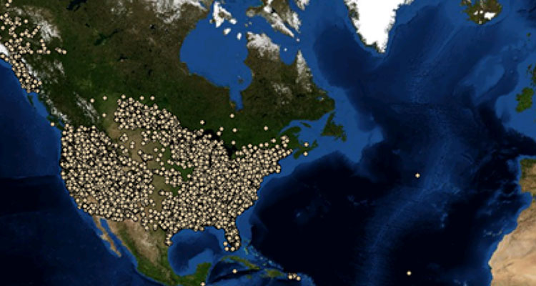
Citizen Science Association
* Why is it important?
* How is it used?
* What do you do with all that data??
* Collaborations with …………
* The essence of ‘out of the 4 walls thinking and education’ – ‘Experiential Education’
* Collaboration with schools, organizations, individuals …and research scientists around the country and the world
(www.citizenscience.org)

Slide 8
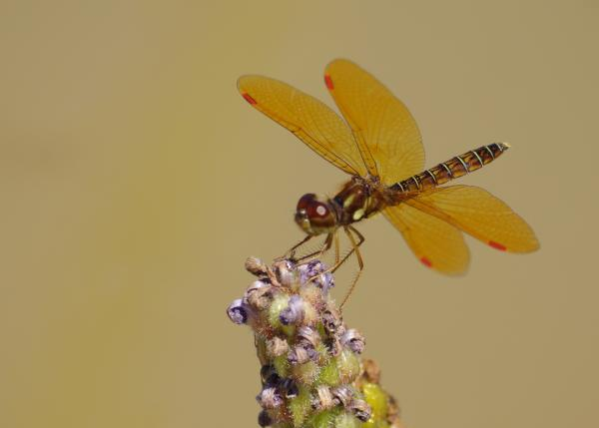
Several Citizen Science Organizations
Cornel Lab of Ornithology (www.birds.cornell.edu)
Nature’s Notebook - National Phenology Network (www.usanpn.org/natures_notebook)
NestWatch (www.nestwatch.org)
MonarchWatch (www.monarchwatch.org)
BumbleBeeWatch (www.bumblebeewatch.org)
Project Budburst (www.budburst.org)
Habitat Network (www.yardmap.org)
Pond Watch (www.pondwatch.org)
Xerces Society Migratory dragonfly partnership (www.migratorydragonflypartnership.org)

Slide 9
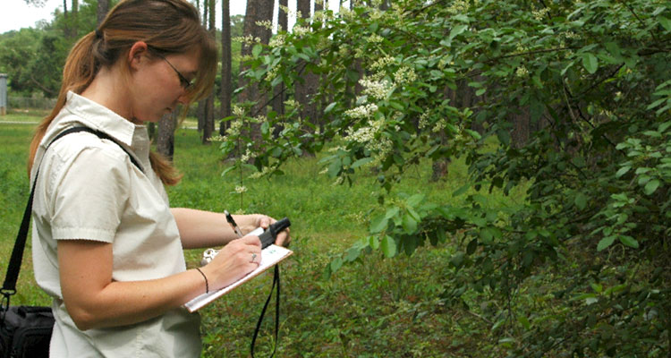
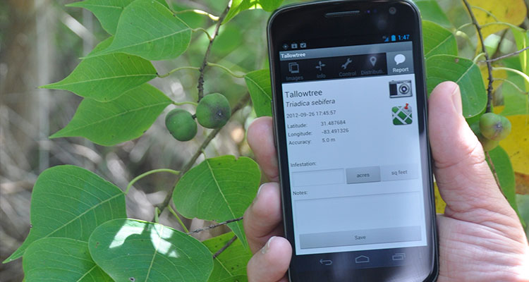
Early Detection and Distribution Mapping System (for invasive species) (https://www.eddmaps.org)
Reporting Invasive Species across US and Canada (https://bugwoodcloud.org)
Finding Science projects: (https://scistarter.com)
International Naturalist – Nature Observations: (https://www.inaturalist.org)
National Geographic Society : (https://www.nationalgeographic.org) “The Great Nature Project’ and ‘ FieldScope’
The Scientific American: Connecting researchers and the public (https://www.scientificamerican.com) : ‘The Plastic Tide’; ‘Michigan Herp Atlas’; ‘Plants of Concern’; ‘Weather-IT’ …….
Bat Detective- researching Pipistrels around the world (https://www.batdetective.org)
The Wonder of Fireflies- FireflyWatch: (https://legacy.mos.org/fireflywatch)

Slide 10
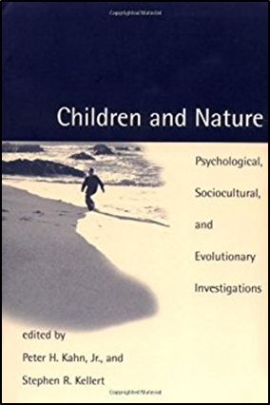
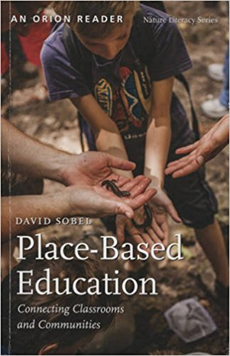
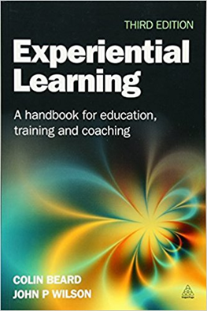
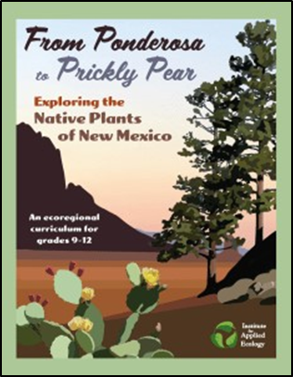
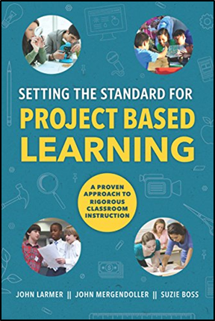
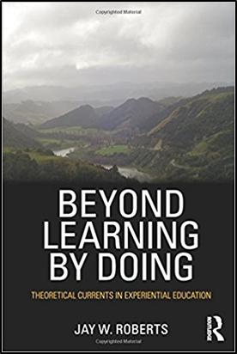
Education, Curriculum and Citizen Science Resource Books

Slide 11
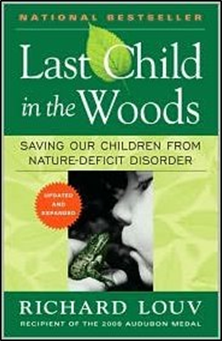
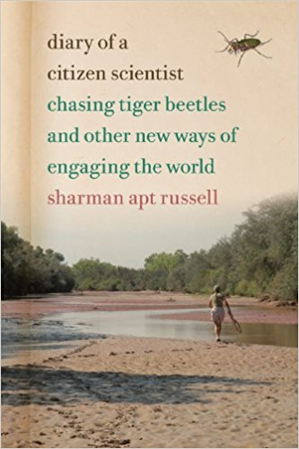
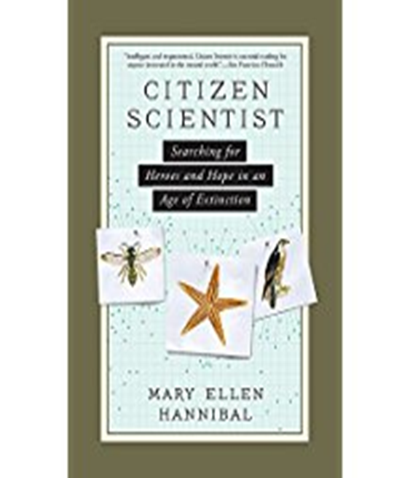
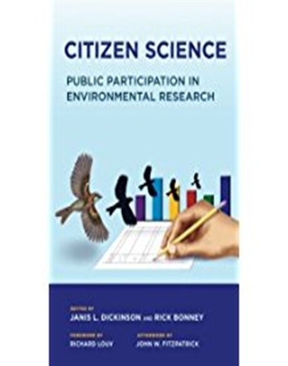
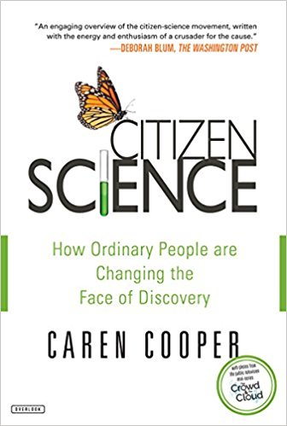

Slide 12
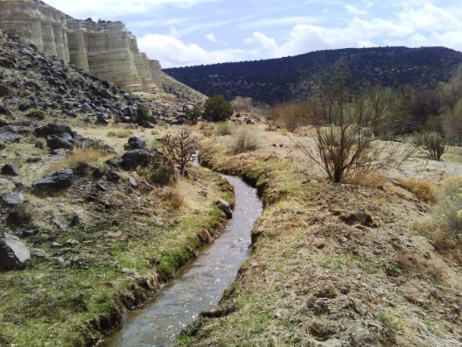
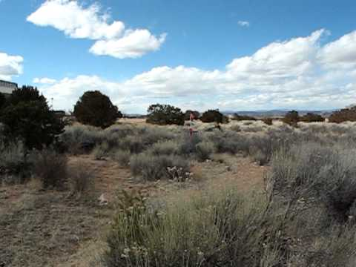
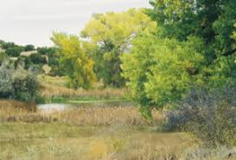
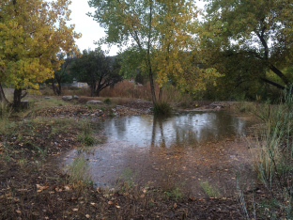
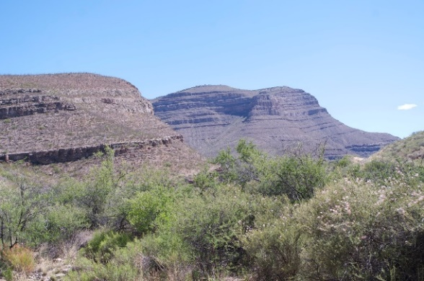
Southwest Ecoregion: Acequias, Swales, Arroyos, Cienegas, Streams, Springs, Vernal ‘ponds’ ….and Bioretention Ponds
Aq
Acequia
Arroyo Chamisos - Santa Fe
Leonora Curtin Cienega
Stormwater - Querencia Green
Hembrillo Canyon Swale

Slide 13
Restoration and Preservation of habitats: Opportunities for collaboration – Research, Education, Citizen Science and community involvement
*Water catchment; bioretention ponds and wetland areas become ‘natural areas’ for education, community and increased biodiversity
*Adapted acequias to hold more native plants – sharing biodiversity
*Riparian areas that are undergoing streambank stabilization , restoration and monitoring
*Short grass prairies that are being protected, reseeded and restored
*Arroyos and revetments that are going through communities
*Roadside areas where seed collection is taking place
*Springs that are identified, monitored, preserved and protected
*Caves and cave systems that are being monitored for biodiversity
*Cienegas that are undergoing restored water tables and increased biodiversity

Slide 14
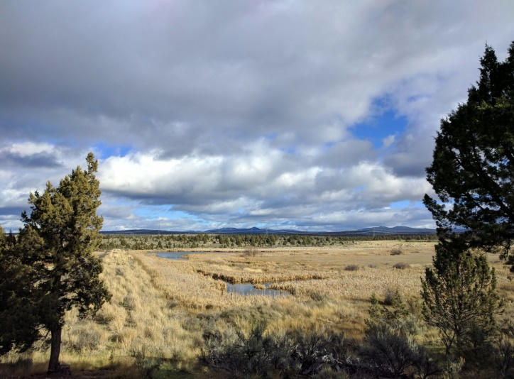
‘Postage Stamp Habitats’ ‘Migratory Waystations’
ESSENTIAL INGREDIENTS:
Water that is slowed down, held or pooled
Native plants (specific to habitat, ecoregion and zone) protected, seeded or planted
Wind breaks and perches for birds and wildlife- preserved/protected or created
Old growth trees , or simulated, for nesting and protection (existing snags, deadfall, birdhouses, decayed logs, etc)
Protection and monitoring of water quality

Slide 15
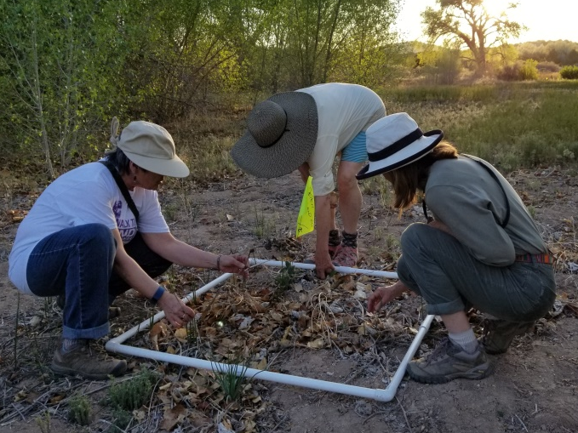
Research Opportunities
Pre and Post habitat restoration and/or ‘natural area’ creation – sampling, characterization, monitoring through quadrat sampling and transect studies, photographic monitoring, oral histories, inventory tools
Consistent monitoring of habitats, species, water quality and flow, restored areas, health
Using Citizen Science programs to collaborate, collect data and analyze data of different sites in different habitats and ecoregions

Slide 16
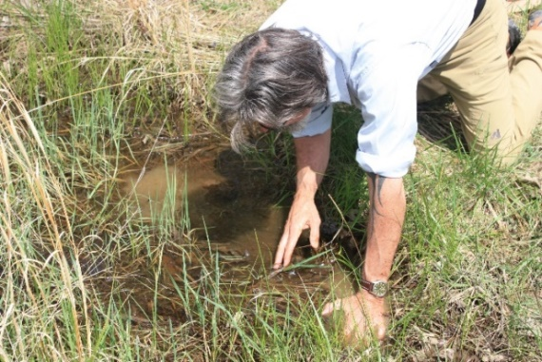
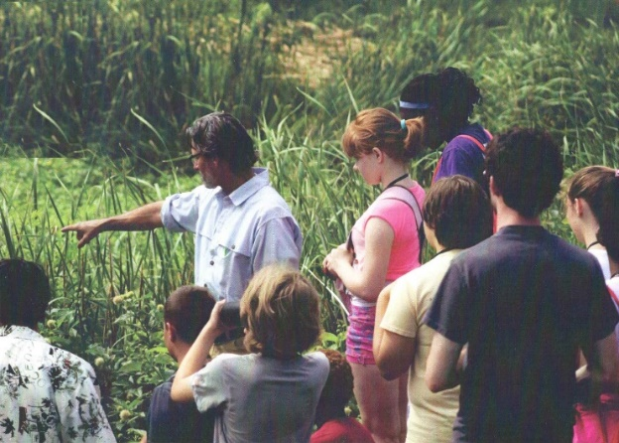
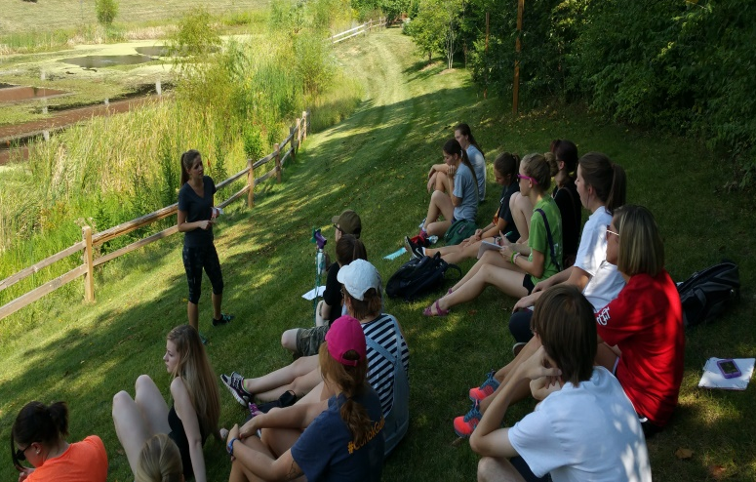
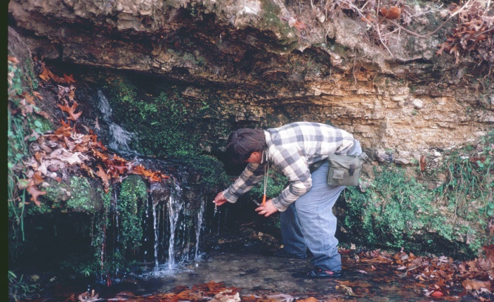
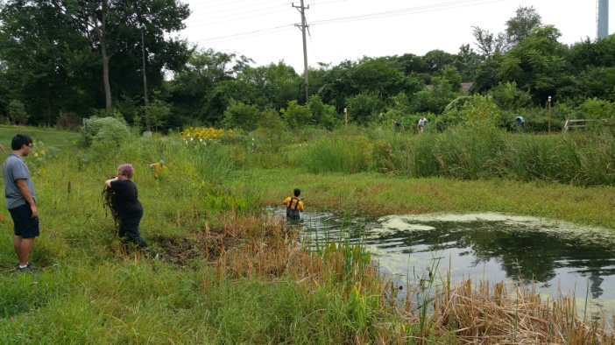
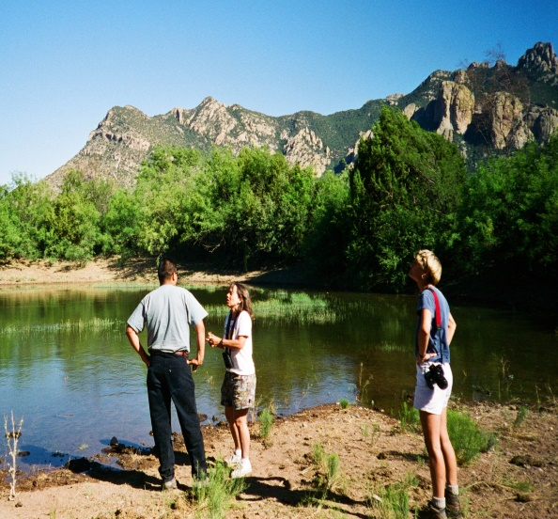
Examples of research and education: Bioretention Pond, Vernal pools, Springs, Wetlands

Slide 17
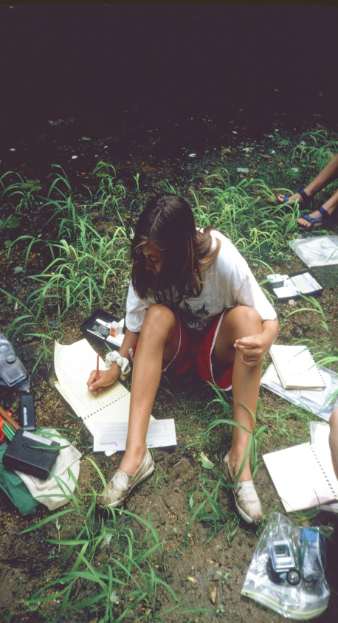
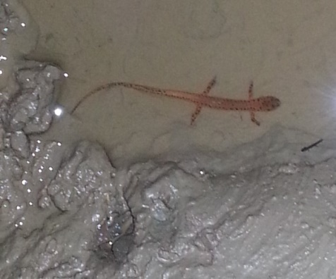
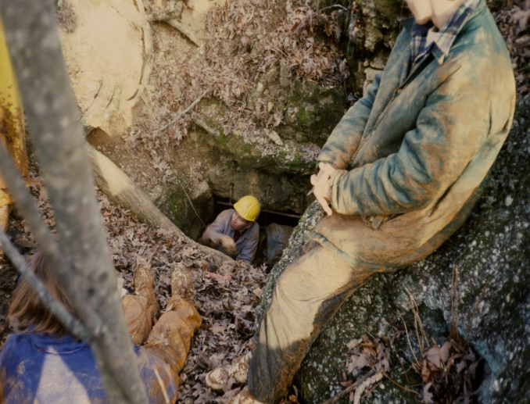
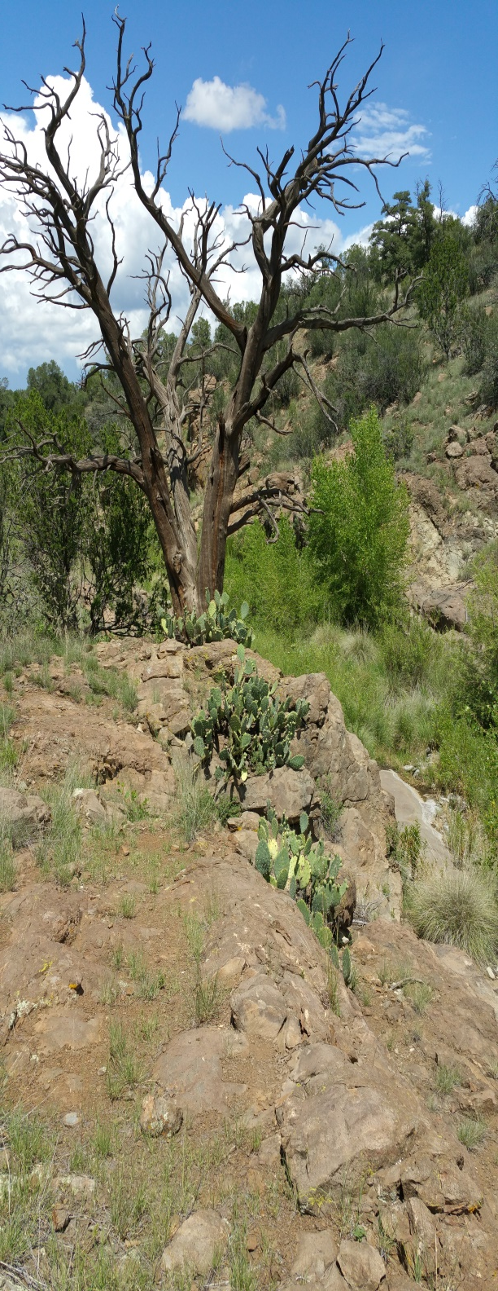
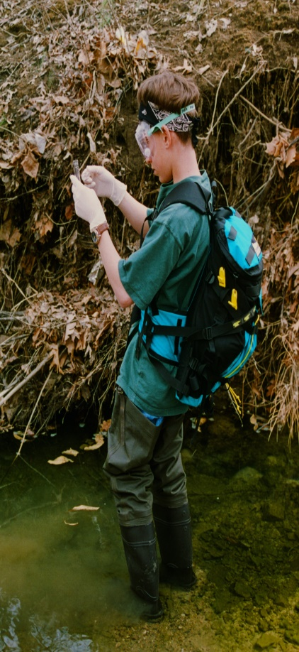
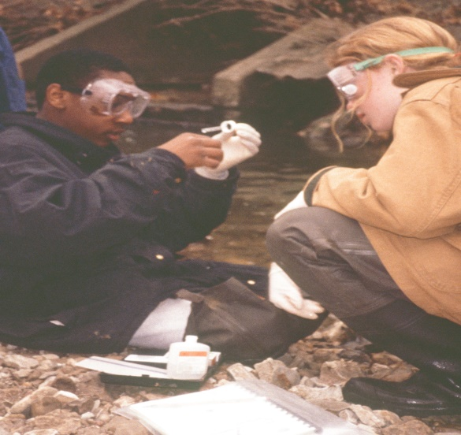
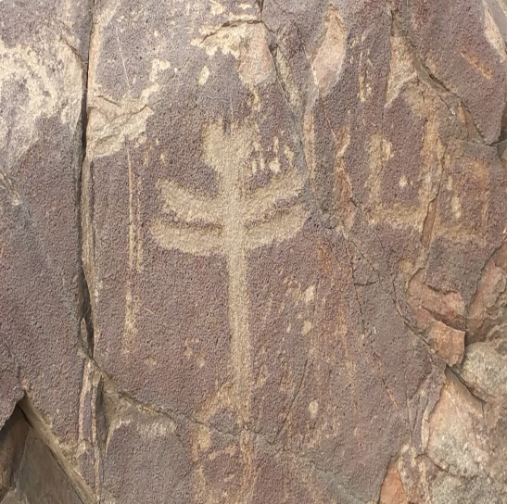

Slide 18
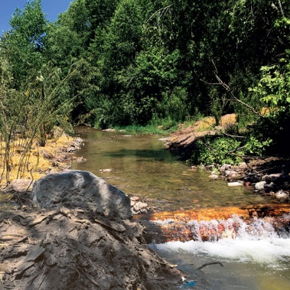
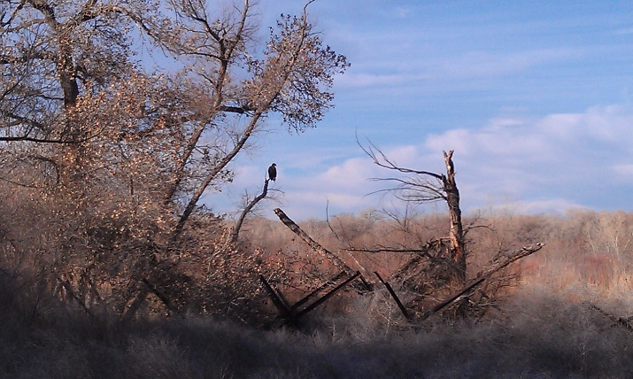
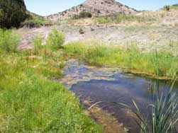
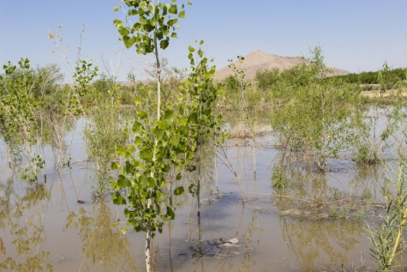
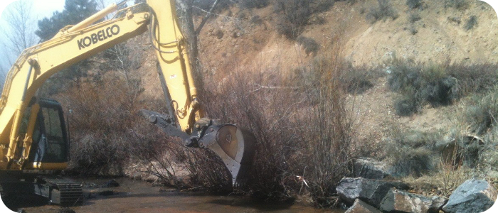
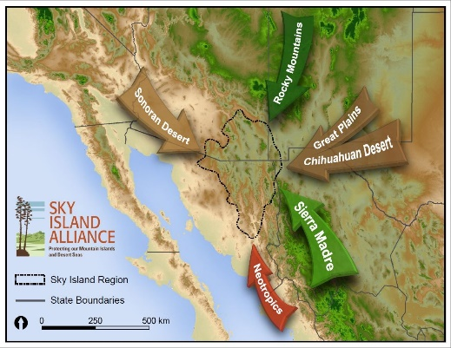
Examples of Research, Education, Community Involvement and Citizen Science: Habitat Restoration
Chihuahua chub habitat-Mimbres River
Middle Rio Grande Ecosystem Restoration
Rio Grande Water Restoration
NM Fish and Wildlife Restoration
Red River Water Restoration
Sky Island Alliance

Slide 19
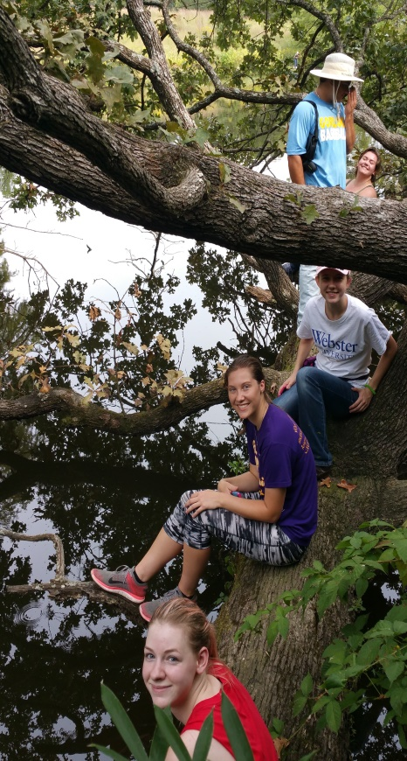
Why is this important? Why should we care?
Education of public and community – ‘all hands on deck’
Community involvement in projects that they live with, are committed to and enjoy
Research, monitoring, inventory work – preservation and protection of springs and wetlands
Habitat Creation, Restoration, Preservation = increased biodiversity
Creation of ‘natural areas’ for biodiversity, study and community enjoyment
Providing protection/habitat/safe spaces for insects, pollinators, migratory animals and wildlife
Bird habitat creation providing additional protected migratory and nesting spaces
Consistency of protected ‘natural areas’ – monitoring and inventory
Educational use - getting students, adults and young people ‘out of the 4 walls’

Slide 20
Contact Information:
Consulting, Education, Practice
Creating and restoring habitats, natural areas and Biodiversity
Research and community involvement
www.earthdesigns.com
Jeff Depew
314-422-1496
jcdepew@earthlink.net

